Slide 1
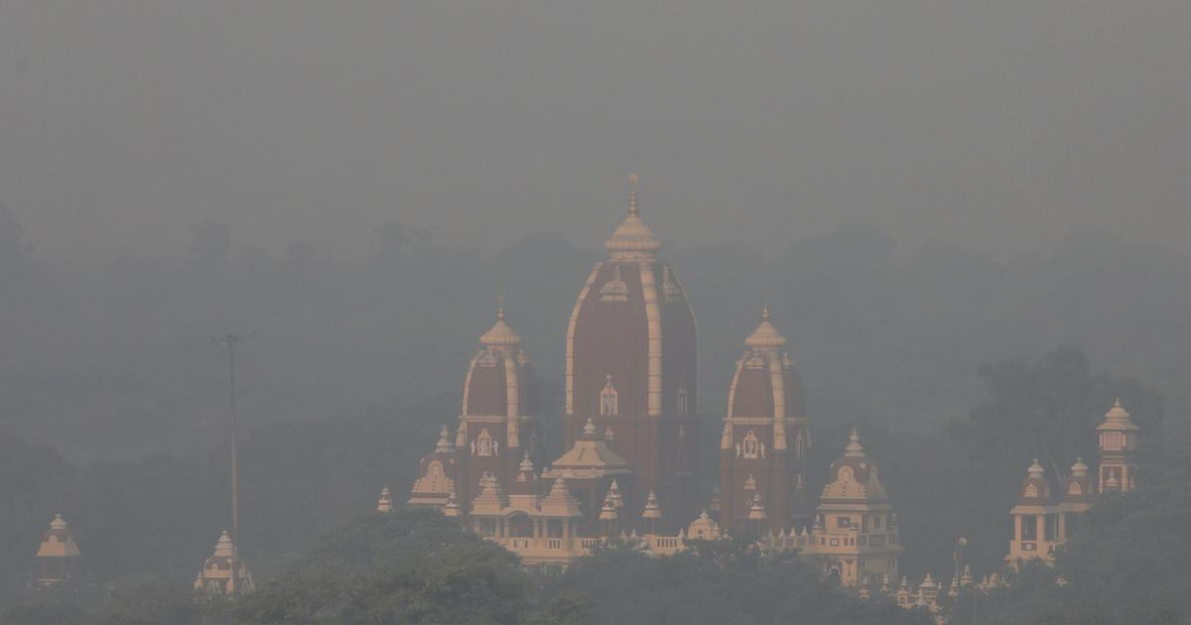
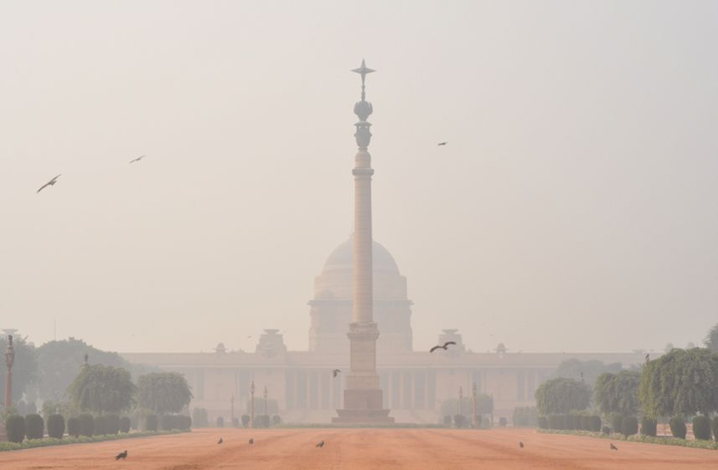
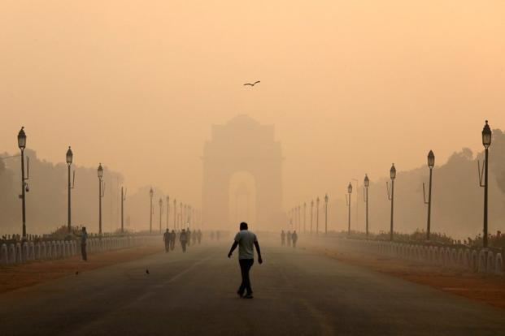
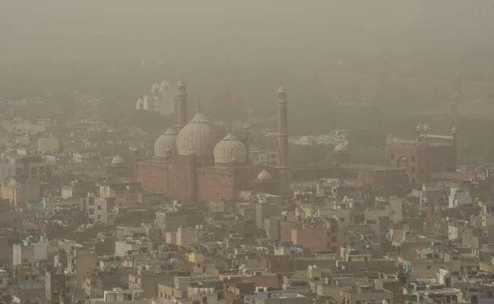
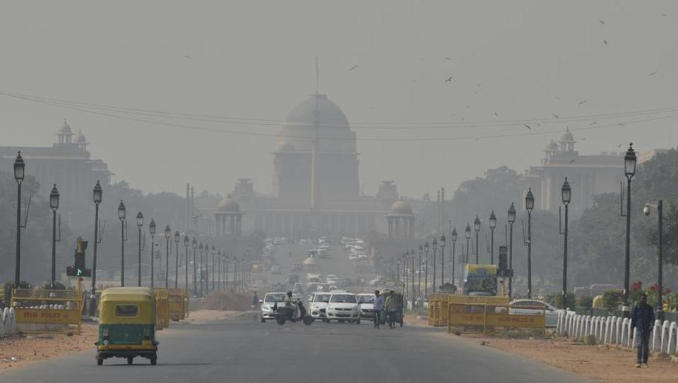


Introduction to Skymet’s Low-Cost Air Quality Monitoring Network in India

Slide 2
About Us
Skymet is India's leading provider of risk management solutions for weather and agriculture.
While popularly known for its weather forecasts, Skymet is a FinTech platform providing insurance companies, banks, and financial institutions with data products and services to support their operations in India.

Slide 3
Need of Low- Cost AQMs
Reference grade air quality monitors (AQM) are very costly and thus practically not viable to install and form a dense network of such sophisticated instruments
Conventional air quality monitors are comparatively cheap but are time consuming and required lot of manpower.
Currently, a range of low-cost air quality monitors with varying technical specification have been available in the market. However, their quality, reliability and performance is unknown.
Therefore, although the air quality monitoring has been conducted, the efforts are very sparse and sporadic. It ultimately leads to create data and knowledge gap that obstructs to define air quality index.

Slide 4
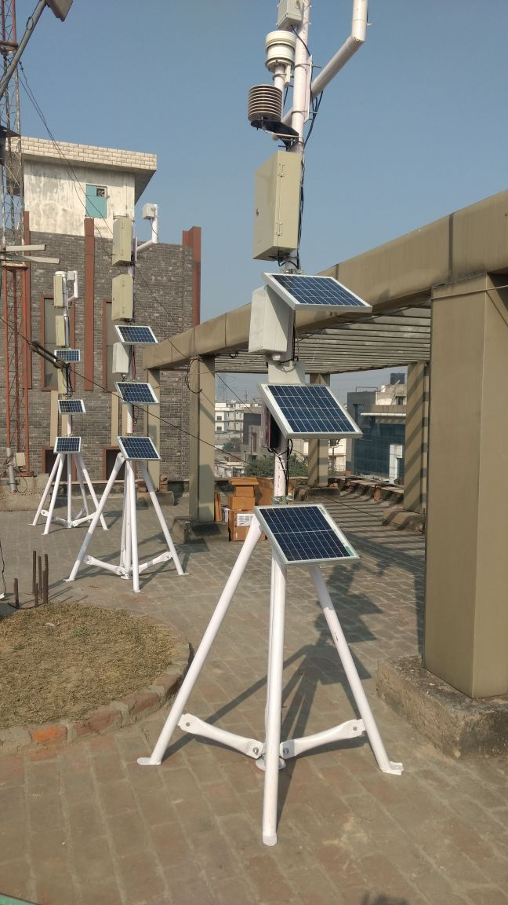
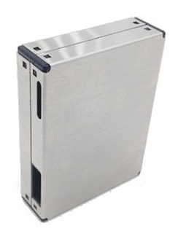
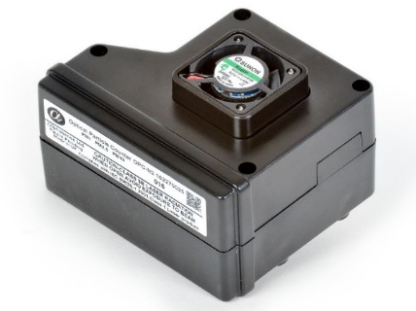
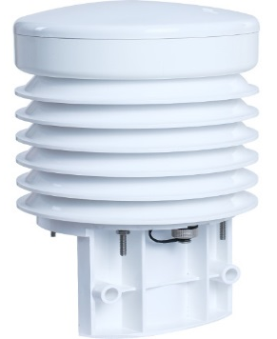
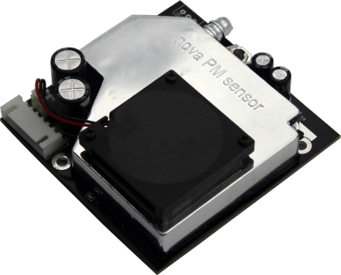
PHASE I- Field Evaluation Of Low-Cost Sensors
Three pairs of each different make and models of low-cost monitors had been used for evaluation.
Defined performance benchmarks for the evaluation.
Based on evaluation study we have selected suitable sensor for the field deployment.

Slide 5
Performance Benchmarks
Sensitivity: is the system’s capability of measuring low and high concentrations.
Accuracy: is how well the system reproduces the same values as the reference method.
Precision: is how well concentrations measured by two or more systems compare. This can be addressed by collocating all instrumentation, with air intakes located as close to one another as possible.
Data recovery: is percent of hourly (or other interval) data values that were collected, divided by the total number of expected data intervals in the date range.
Sensor uptime: is the percent of time the sensor systems were in operation, divided by the total expected amount of time. This is closely related to the data recovery statistic.

Slide 6
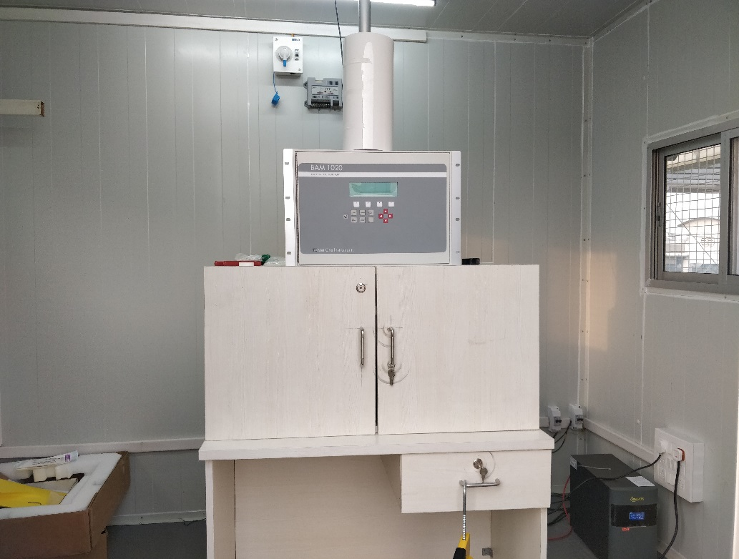
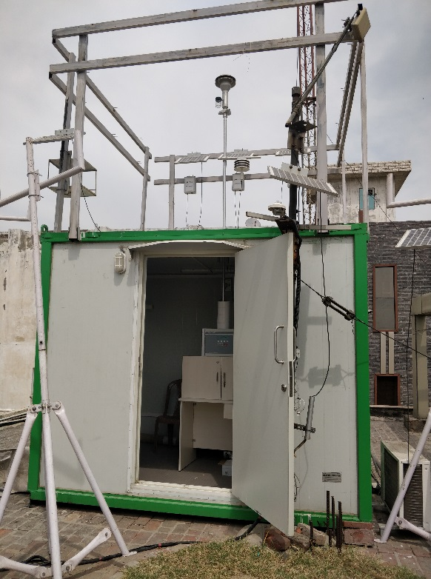
Calibration
Beta Attenuation Monitor (BAM) is used as a reference monitor for the calibration.
Collocated measurements of BAM and low-cost AQMs in batches.
Impact of relative humidity and temperature on the sensor response.
Three low-cost air quality monitors are continuously conducting collocated measurements with BAM

Slide 7
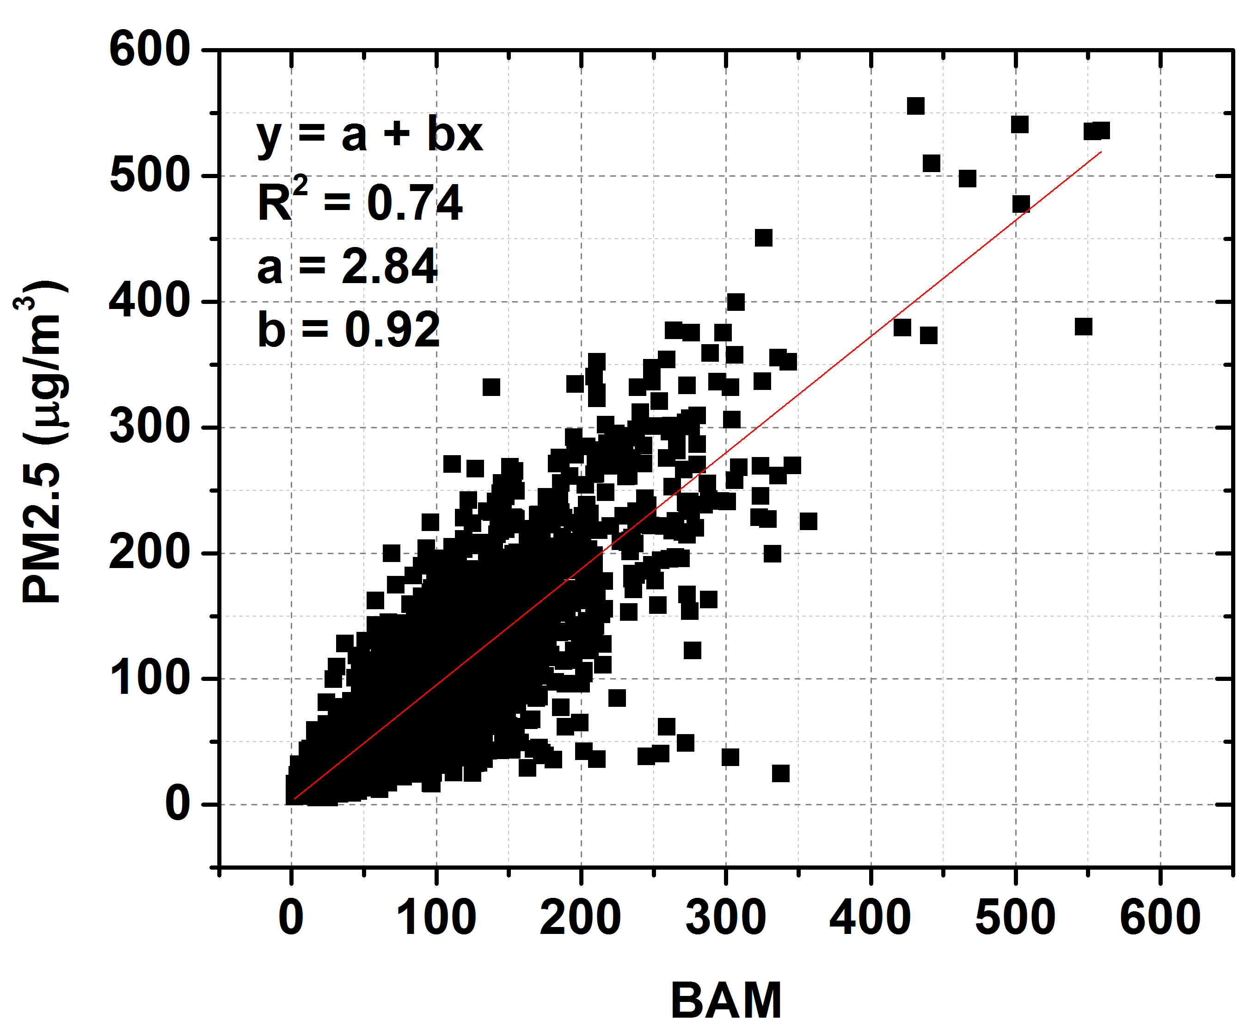
Calibration
Correlation graph of BAM vs Low-cost Monitor

Slide 8
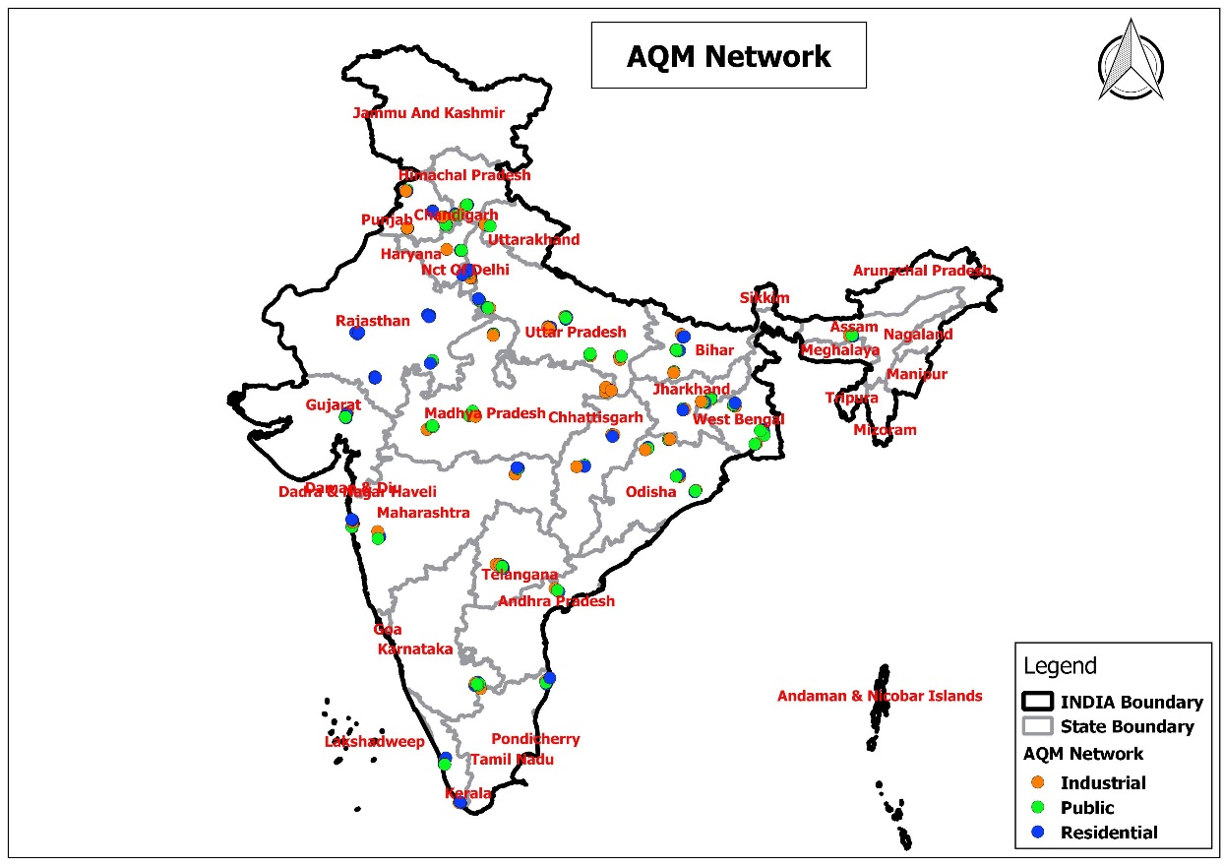
PHASE II- Deployment
Installed 300 AQMs in 55 cities of 22 states in India
Representativeness of the AQM locations:
  Industrial Area
  Residential Area
  Public Places

Slide 9
Comparison Study
Hourly concentration in Oct-Nov-Dec months, 2019

Slide 10
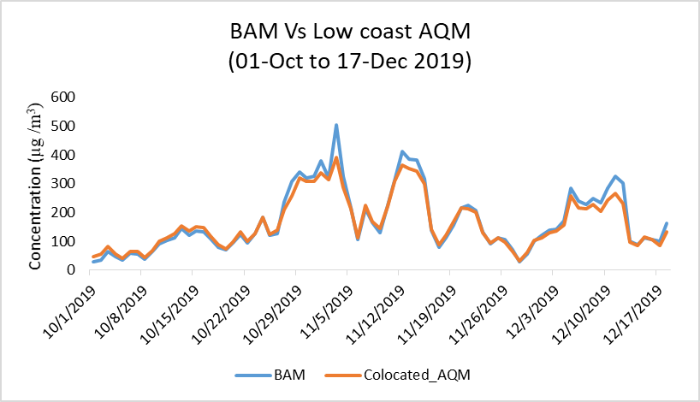
Comparison Study
Daily variation of PM_{2.5} concentration during 1st Oct to 17th Dec 2019

Slide 11
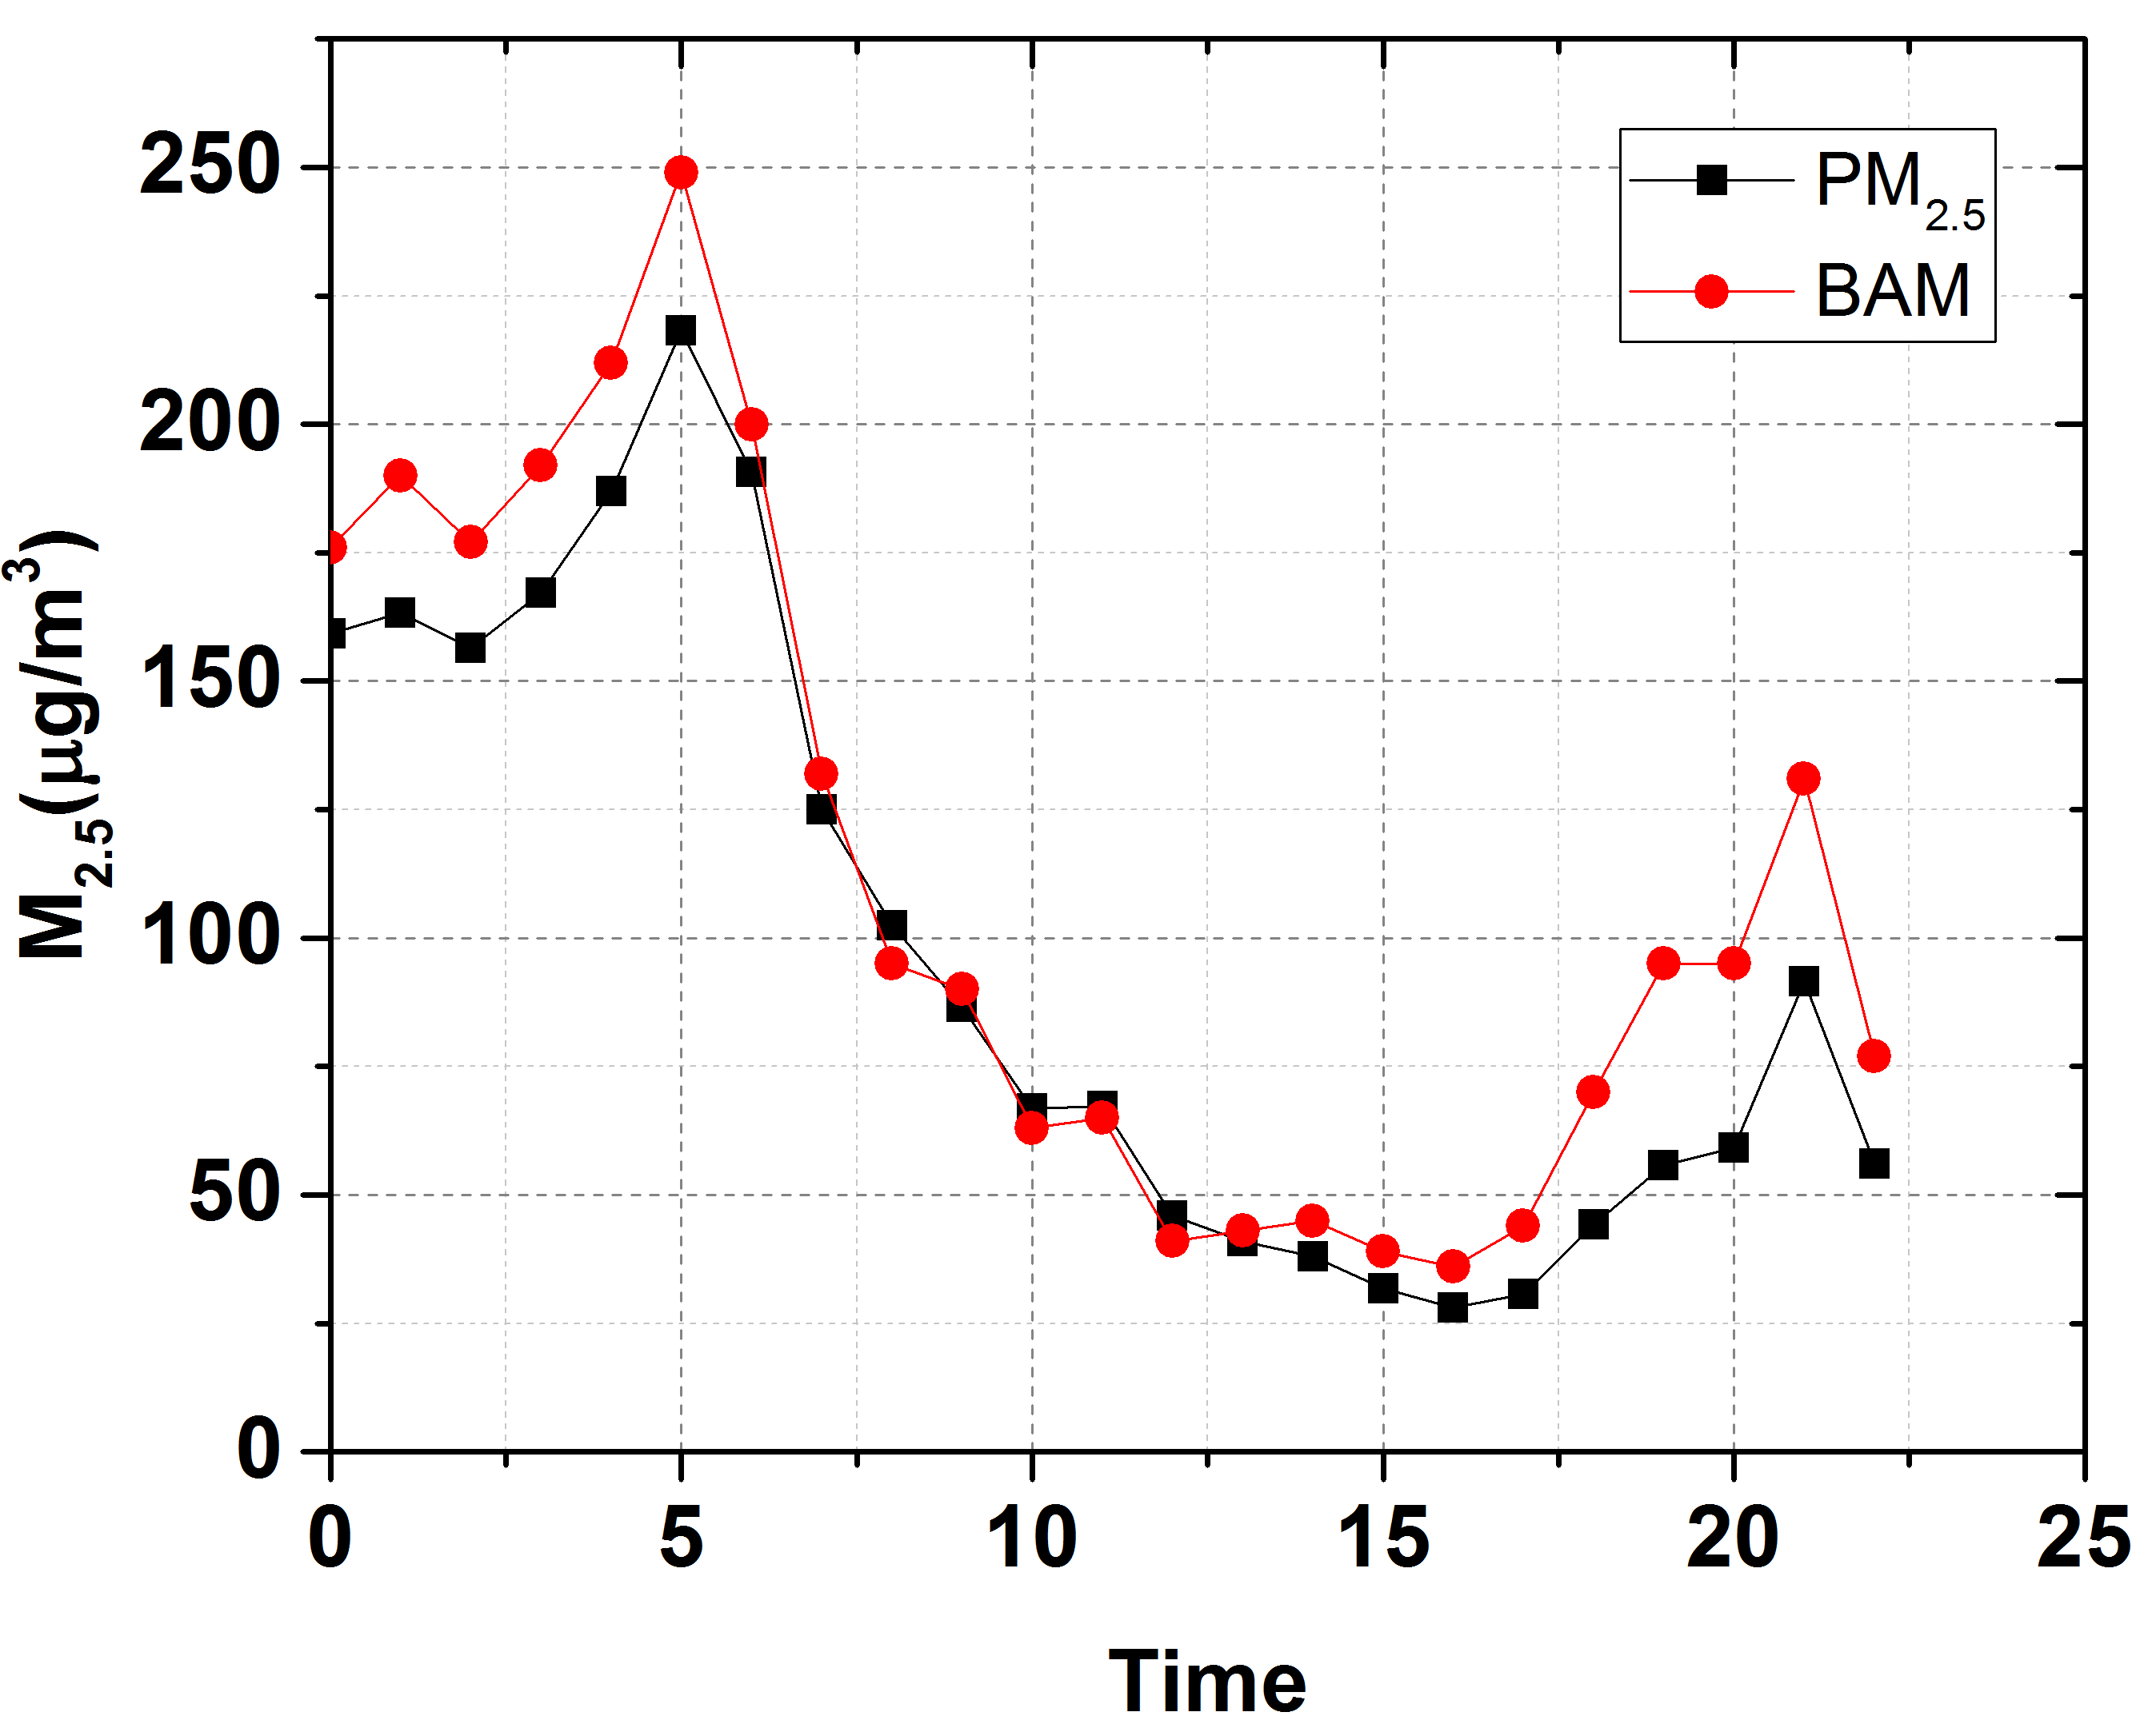
Comparison Study
Diurnal variation of PM_{2.5} concentration

Slide 12
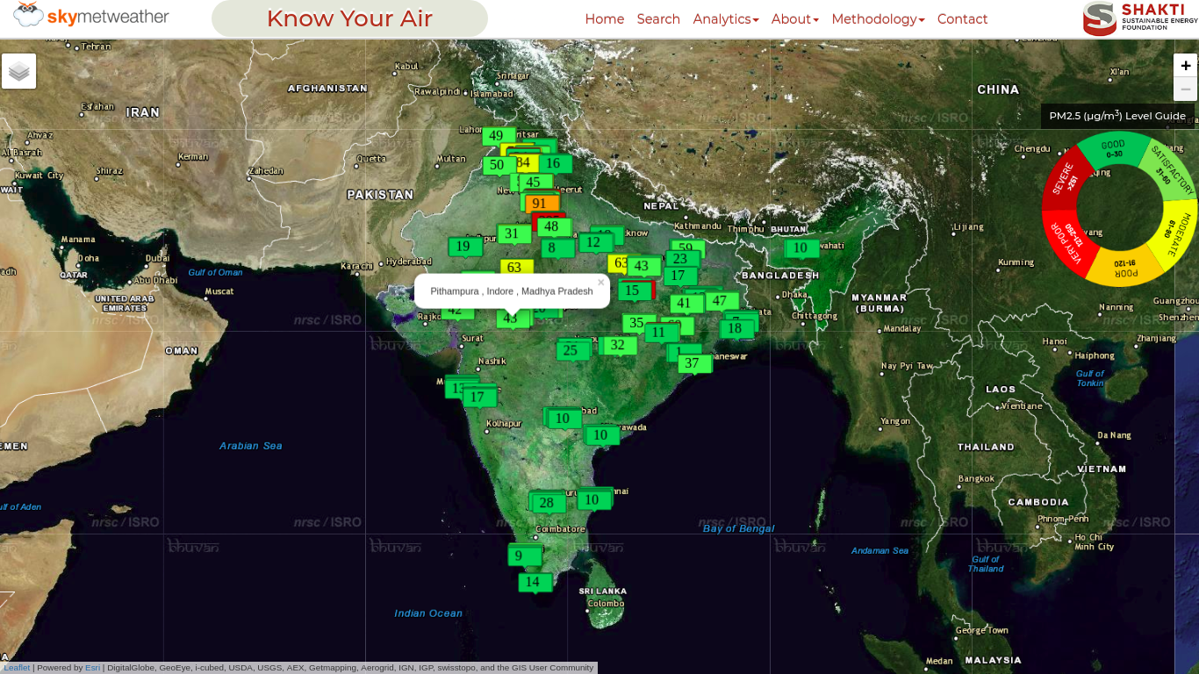
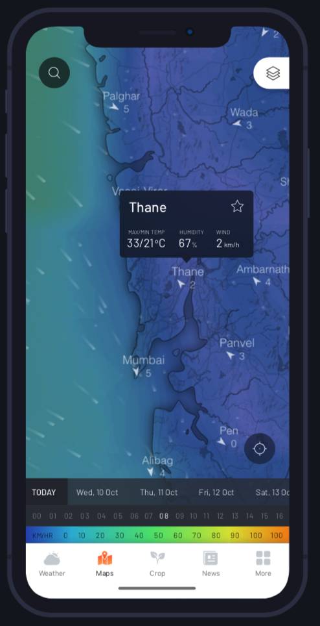
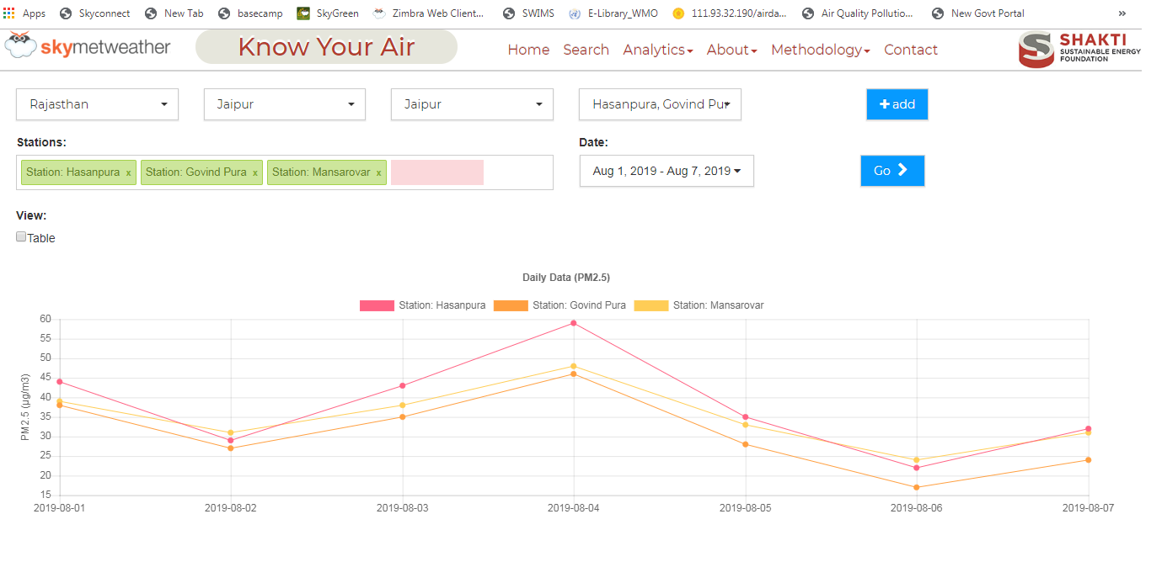
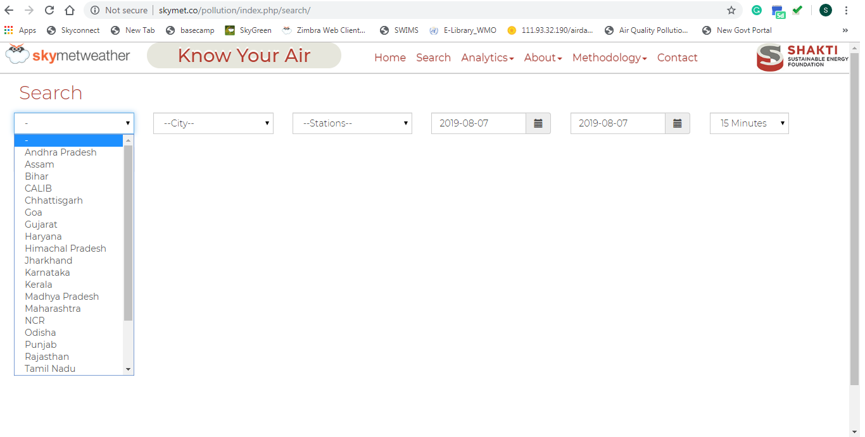
Data Delivery Platforms
APIs also can be provided for bulk access of data

Slide 13
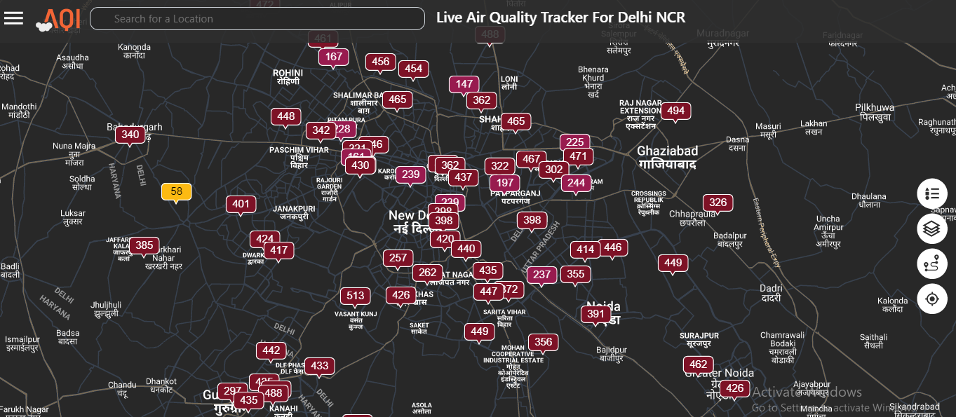
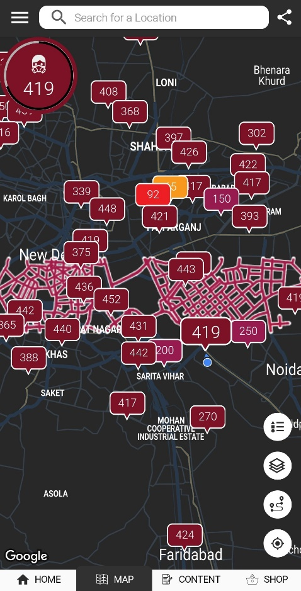
Data Delivery Platforms
Skymet AQI Web Platform
Desktop and Mobile friendly
URL: https://www.skymetweather.com/air-quality/
Skymet AQI APP
Available on Play store
URL:https://play.google.com/store/apps/details?id=com.skymet.skymetaqi

Slide 14
Data Delivery Platforms
Skymet AQI provides AQI, PM 2.5, PM 10, Temperature, Rainfall and Humidity data for over 50 locations in Delhi NCR, and over 250 locations in India

Slide 15

Data Delivery Platforms
Skymet AQI App is launched in the month of November is currently has over 12,000 downloads, with an average rating of 4.4
Skymet AQI Web Platform is launched in the month of October and has over 50K monthly users

Slide 16
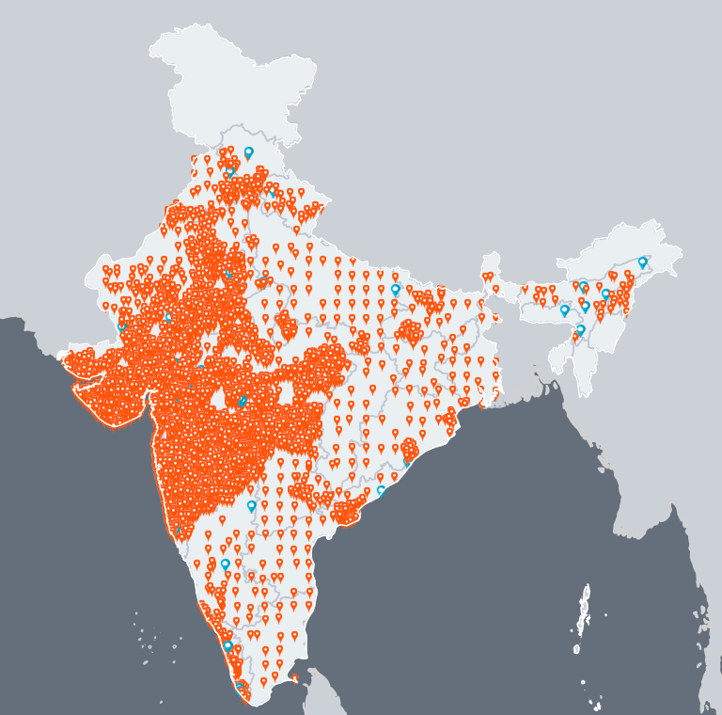
Way Forward
Developed network will continue to operate and will provide free data access for public goods
We are expanding dense network in 10 cities.
Each of Skymet’s existing 7000+ AWS will be equipped with PM sensors
Developing Hybrid Network
Developing Methodology for on-field/real-time calibration
Developing capabilities to do Hyper Local Air Quality forecasting

Slide 17
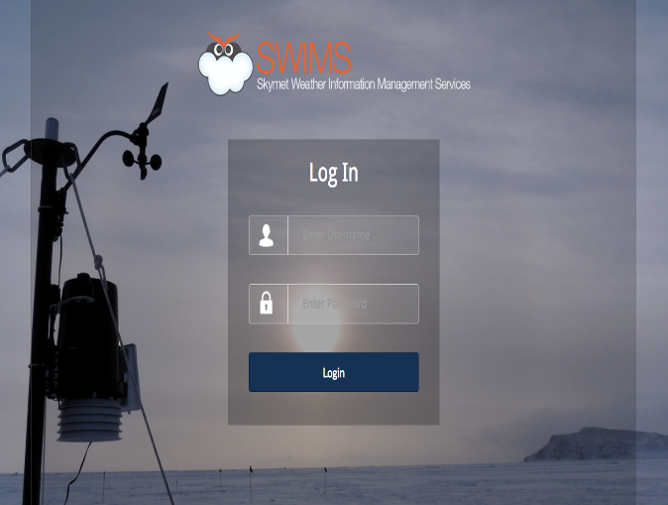
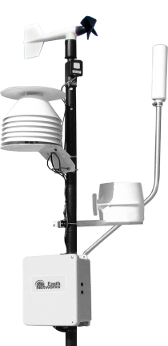
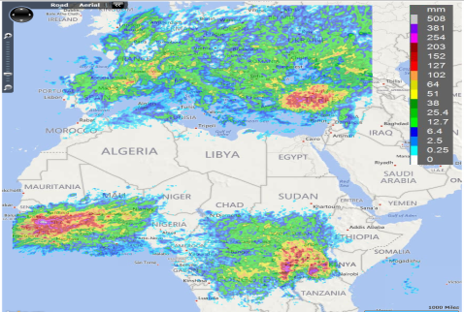

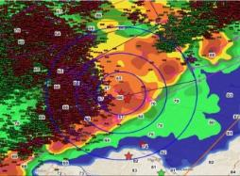
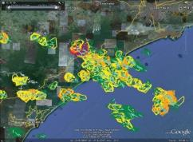
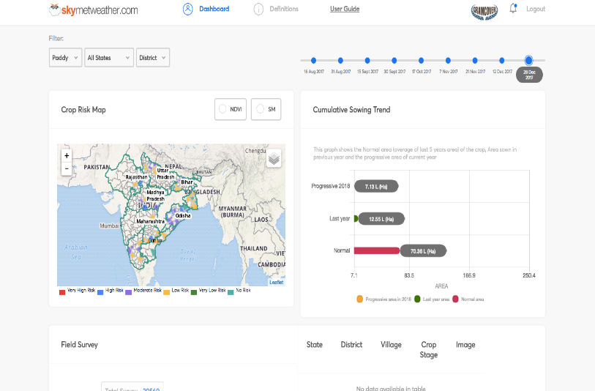
THANK YOU!

